Slide 1
ALGEBRA 4
Day 56

Slide 2
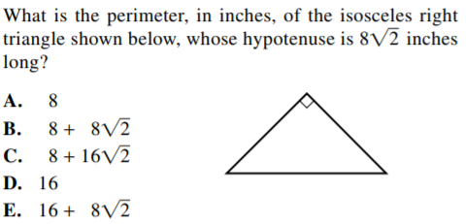
Bell Work

Slide 3
Quiz 11.1 – 11.3
Level 2: Factorials, Permutations, Combinations, Basic Probability
Level 3: Applied Perm/Combo, Probability (with and)
Level 4: Applied Perm/Combo with and/or

Slide 4
From Last Time
page 691 #1-7, 9-12, 13-31 (odd)

Slide 5
Probability of A and B (Independent):
If A and B are independent events, then the probability that both A and B occur is:
P(A and B) = P(A) * P(B)
Probability of A and B (Dependent):
The probability that event B will occur given that A has already occurred:
P(A and B) = P(A) * P(B|A) ← prob of B given A

Slide 6
Mutually Exclusive Events: Event A and Event B share no intersection.
P(A and B) = 0
Probability of A or B:
If A and B are independent events, then the probability that both A and B occur is:
P(A or B) = P(A) + P(B) – P(A and B)

Slide 7
If event A is drawing a queen from a deck of cards and event B is drawing a king from the remaining cards, are the events A and B dependent or independent?
If event A is rolling a two on a six-sided die and event B is rolling a four on a different six-sided die, are the events A and B dependent or independent?

Slide 8
If event A is drawing a queen from a deck of cards and event B is drawing a king from the remaining cards, are the events A and B dependent or independent?
Dependent
If event A is rolling a two on a six-sided die and event B is rolling a four on a different six-sided die, are the events A and B dependent or independent?
Independent

Slide 9
Examples
Events A and B are independent. Find the indicated probability.
a) P(A) = 0.3 b) P(A) = ___
P(B) = 0.9 P(B) = 0.3
P(A and B) = ____ P(A and B) = 0.06

Slide 10
Examples
Events A and B are independent. Find the indicated probability.
a) P(A) = 0.3 b) P(A) = _.2__
P(B) = 0.9 P(B) = 0.3
P(A and B) = __.27__ P(A and B) = 0.06

Slide 11
A jar contains 12 red marbles, 16 blue marbles, and 18 white marbles.
a) Find the probability of choosing a red marble and then a white marble is chosen with replacement.
b) Three marbles are chosen from the jar with replacement. What is the probability that all are white?
c) Four marbles are chosen from the jar with replacement. What is the probability that none are blue?

Slide 12
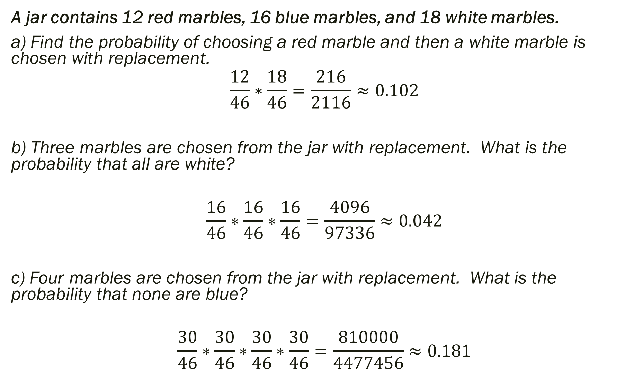
A jar contains 12 red marbles, 16 blue marbles, and 18 white marbles.
a) Find the probability of choosing a red marble and then a white marble is chosen with replacement.
$$\frac{12}{46}∗\frac{18}{46}=\frac{216}{2116}≈0.102$$
b) Three marbles are chosen from the jar with replacement. What is the probability that all are white?
$$\frac{16}{46}∗\frac{16}{46}∗\frac{16}{46}=\frac{4096}{97336}≈0.042$$
c) Four marbles are chosen from the jar with replacement. What is the probability that none are blue?
$$\frac{30}{46}∗\frac{30}{46}∗\frac{30}{46}∗\frac{30}{46}=\frac{810000}{4477456}≈0.181$$

Slide 13
In a survey of 200 pet owners, 103 owned dogs, 88 owned cats, 25 owned birds, 18 owned reptiles.
a) None of the respondents owned both a cat and a bird. What is the probability that they owned a cat or a bird?
b) Of the respondents, 52 owned both a cat and a dog. What is the probability that a respondent owned a cat or a dog?
c) Of the respondents, 119 owned a dog or a reptile. What is the probability that they owned a dog and a reptile?

Slide 14
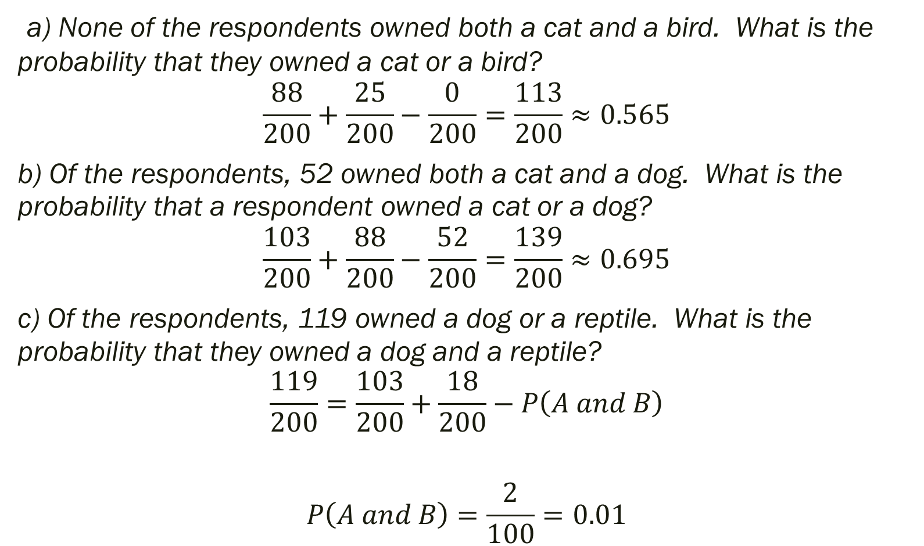
a) None of the respondents owned both a cat and a bird. What is the probability that they owned a cat or a bird?
$$\frac{88}{200}+\frac{25}{200}−\frac{0}{200}=\frac{113}{200}≈0.565$$
b) Of the respondents, 52 owned both a cat and a dog. What is the probability that a respondent owned a cat or a dog?
$$\frac{103}{200}+\frac{88}{200}−\frac{52}{200}=\frac{139}{200}≈0.695$$
c) Of the respondents, 119 owned a dog or a reptile. What is the probability that they owned a dog and a reptile?
$$\frac{119}{200}=\frac{103}{200}+\frac{18}{200}−P\left(A and B\right)$$
$$P\left(A and B\right)=\frac{2}{100}=0.01$$

Slide 15
11.4 Conditional Probability
Objective: To find conditional probabilities

Slide 16
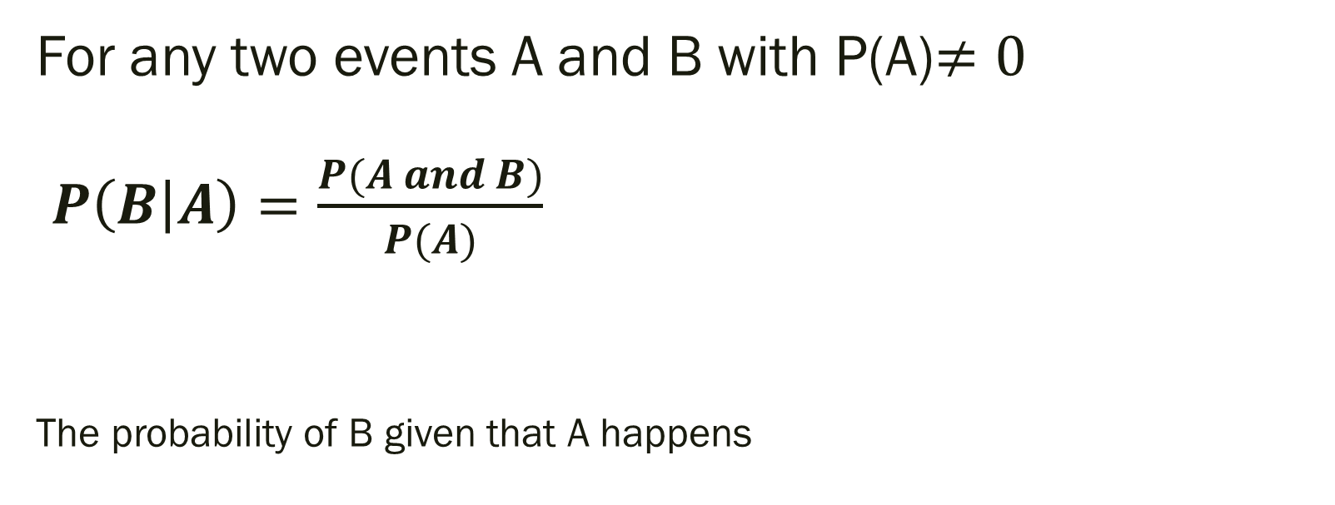
Conditional Probability:
For any two events A and B with P(A)$≠0$ $P\left(B | A\right)=\frac{P(A and B)}{P(A)}$
The probability of B given that A happens

Slide 17
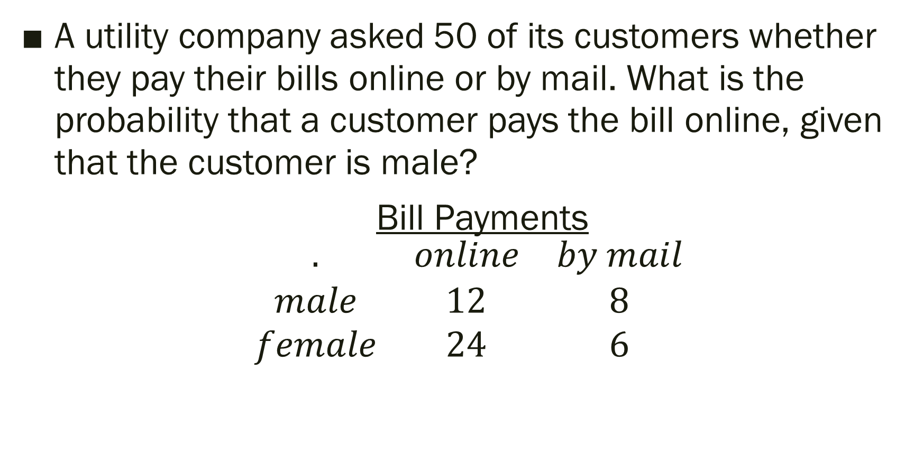
Example
A utility company asked 50 of its customers whether they pay their bills online or by mail. What is the probability that a customer pays the bill online, given that the customer is male?
Bill Payments
$$\begin{matrix}. & online & by mail \\ male & 12 & 8 \\ female & 24 & 6\end{matrix}$$

Slide 18
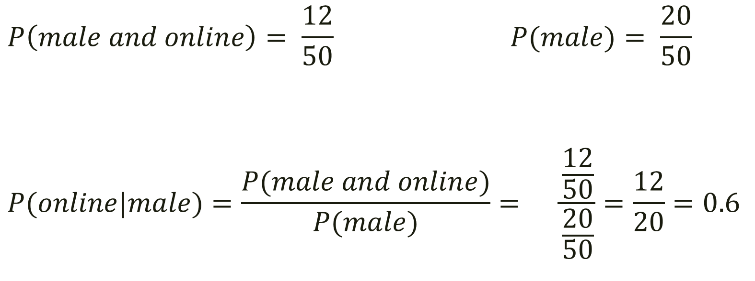
Answer
$$P\left(male and online\right)= \frac{12}{50} P(male)= \frac{20}{50}$$
$$P(online|male)=\frac{P(male and online)}{P(male)}= \frac{\frac{12}{50}}{\frac{20}{50}}=\frac{12}{20}=0.6$$
The probability that a customer pays online given that the customer is male is 60%.

Slide 19
Think deeper…
Could we find the probability of customer paying by mail given that she is a female?
What other scenarios could we attempt to find?

Slide 20
For Next Time
page 700 #1-5, 9-17 (odd)

